Slide 1
BB2950 Day 7: Friday 11-3-17
Learning objectives:
Describe the common protein secondary structural elements and the types of bonds that form them.
Define protein tertiary and quaternary structure and describe the types of bonds that produce them.
Describe how DNA binding proteins interact with DNA in sequence-specific and non-sequence-specific manners.
Describe the composition of viral, prokaryotic, and eukaryotic genomes with respect to nucleic acid usage and strandedness.

Slide 2
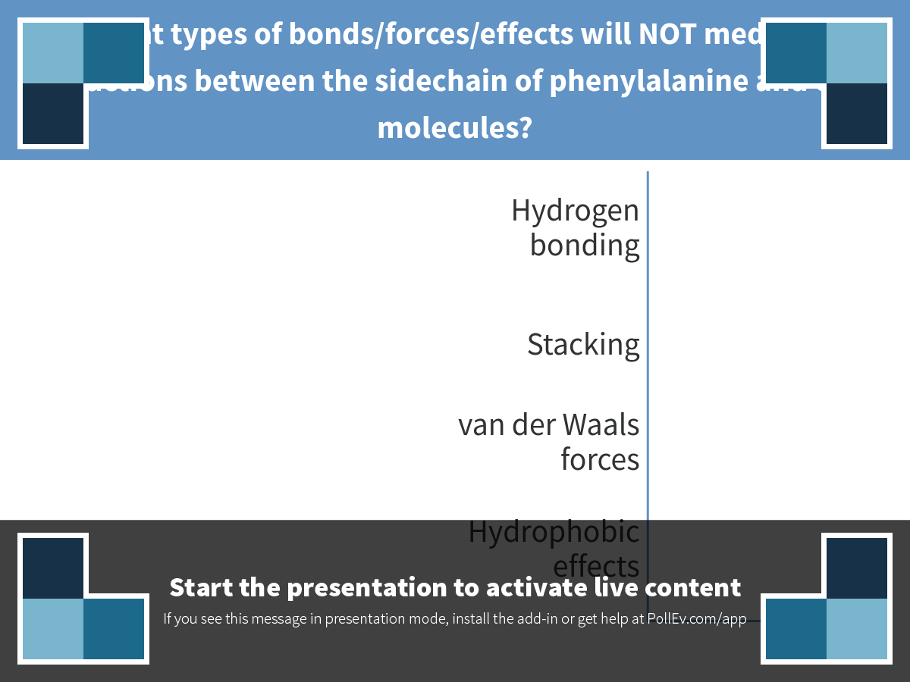
Notes:
What types of bonds/forces/effects will NOT mediate interactions between the sidechain of phenylalanine and other molecules?
https://www.polleverywhere.com/multiple_choice_polls/Un8dS3sTTNaIgvp

Slide 3
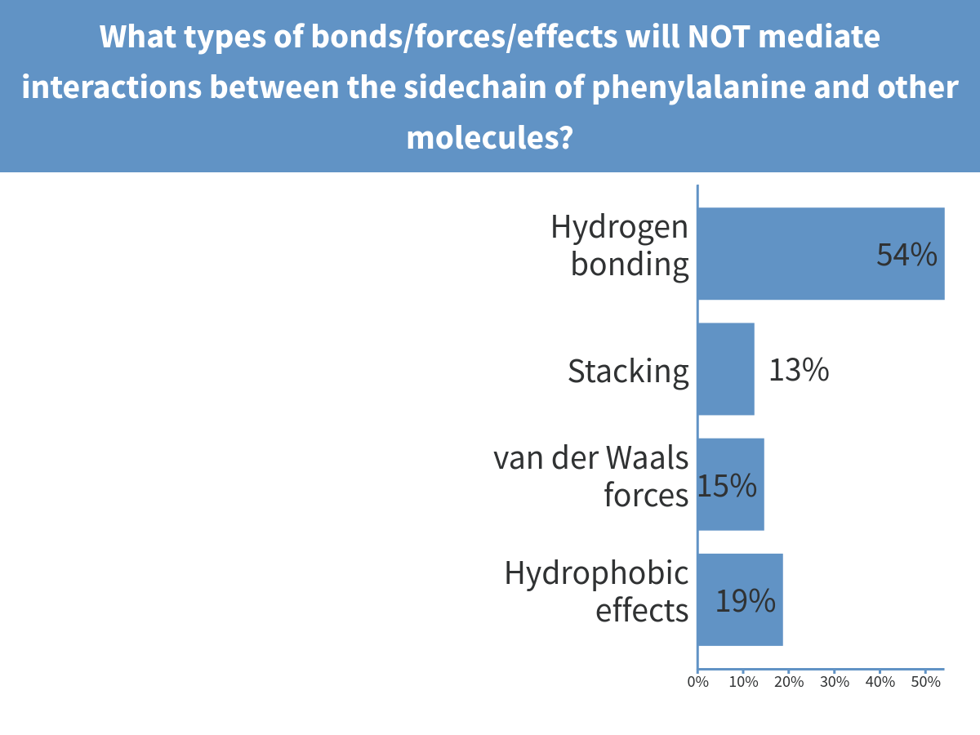
Notes:
What types of bonds/forces/effects will NOT mediate interactions between the sidechain of phenylalanine and other molecules?

Slide 4
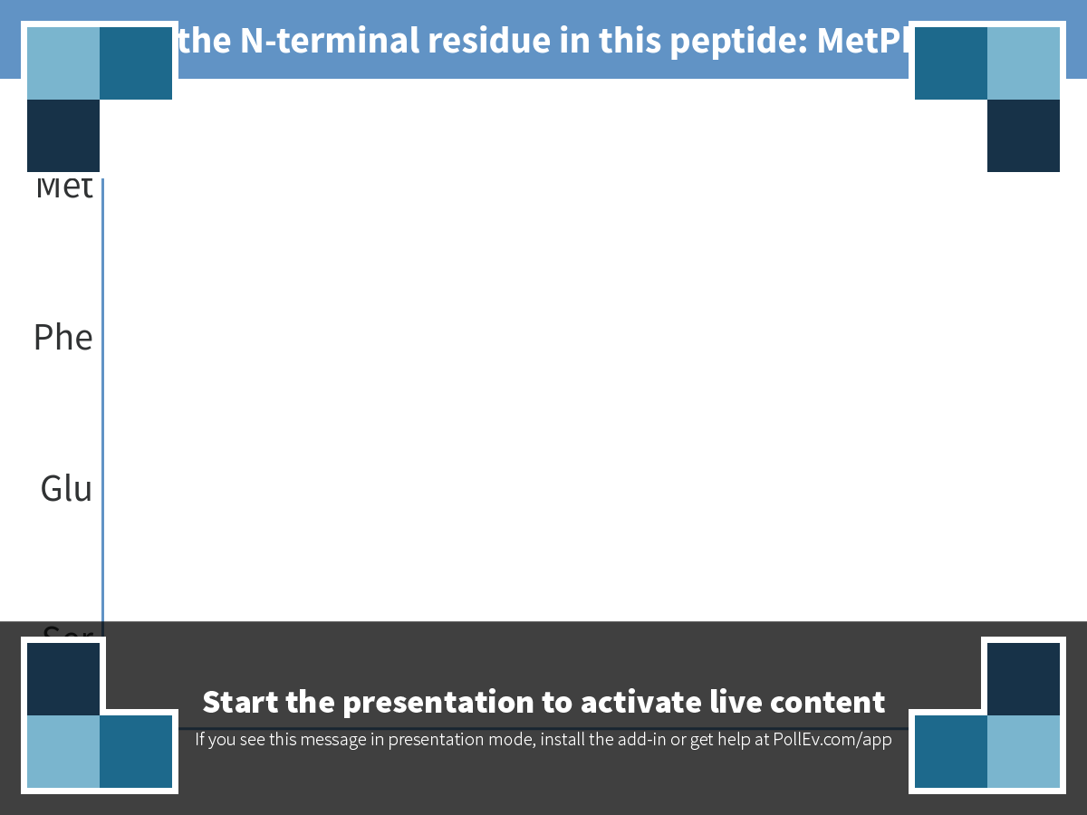
Notes:
Which is the N-terminal residue in this peptide: MetPheGluSer
https://www.polleverywhere.com/multiple_choice_polls/OIlYujevxkZF2rB

Slide 5
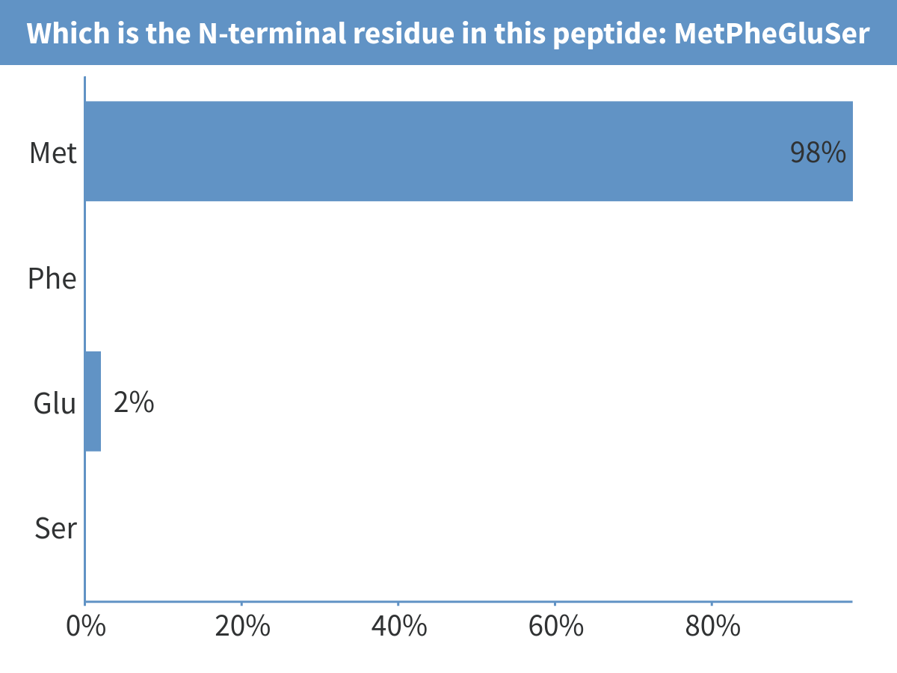
Notes:
Which is the N-terminal residue in this peptide: MetPheGluSer

Slide 6
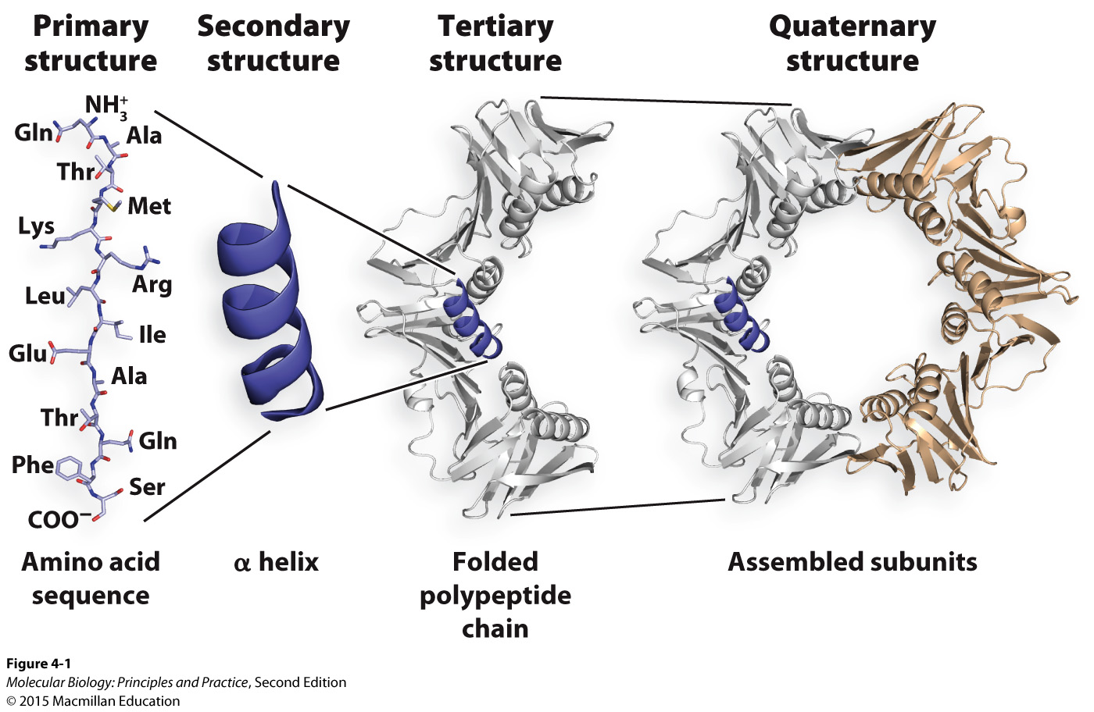
Levels of protein structure

Slide 7
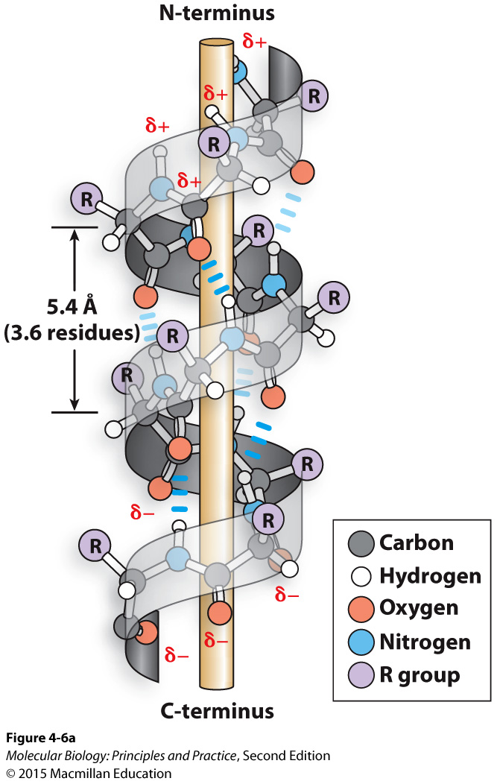
Secondary structure option 1: alpha helix
What kind of bonds hold this alpha helix together?
What is the role of the side-chains in this structure?

Slide 8
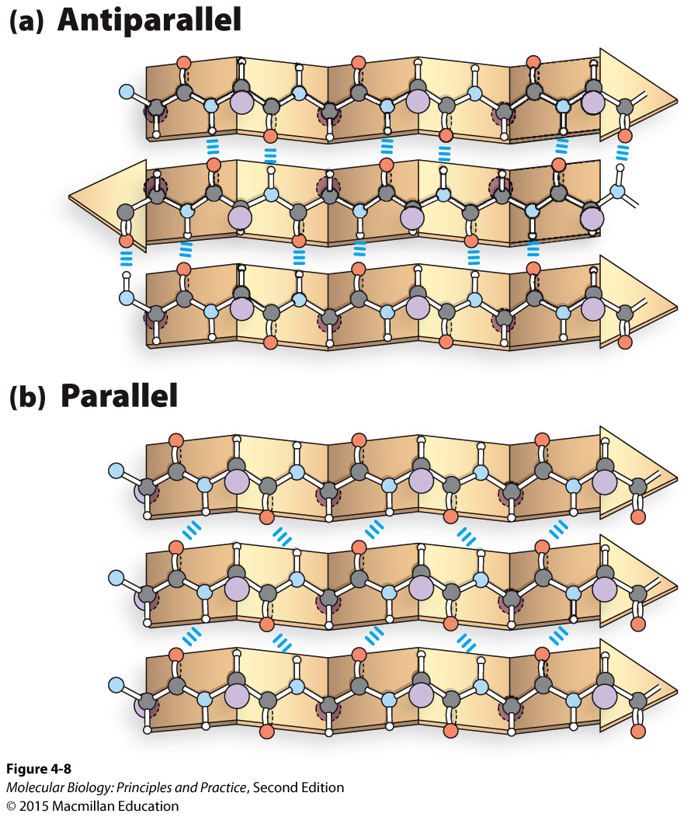
Secondary structure option 2: beta sheet
What kind of bond holds these beta sheets together?
What is the role of the side-chains in these structures?

Slide 10
The chemical forces that underlie protein tertiary and quaternary structure

Slide 11
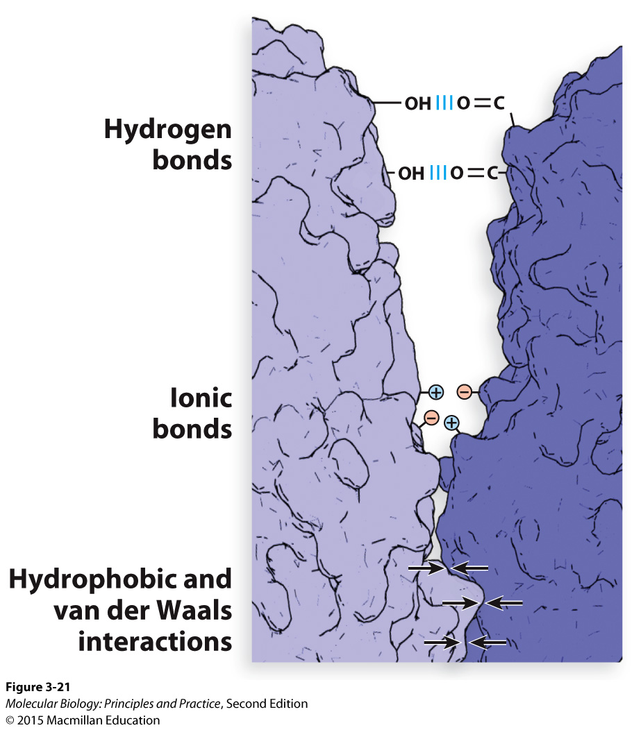

Slide 12
How do proteins bind to nucleic acids?
Protein-nucleic acid interactions can be sequence-specific or non-sequence-specific

Slide 13
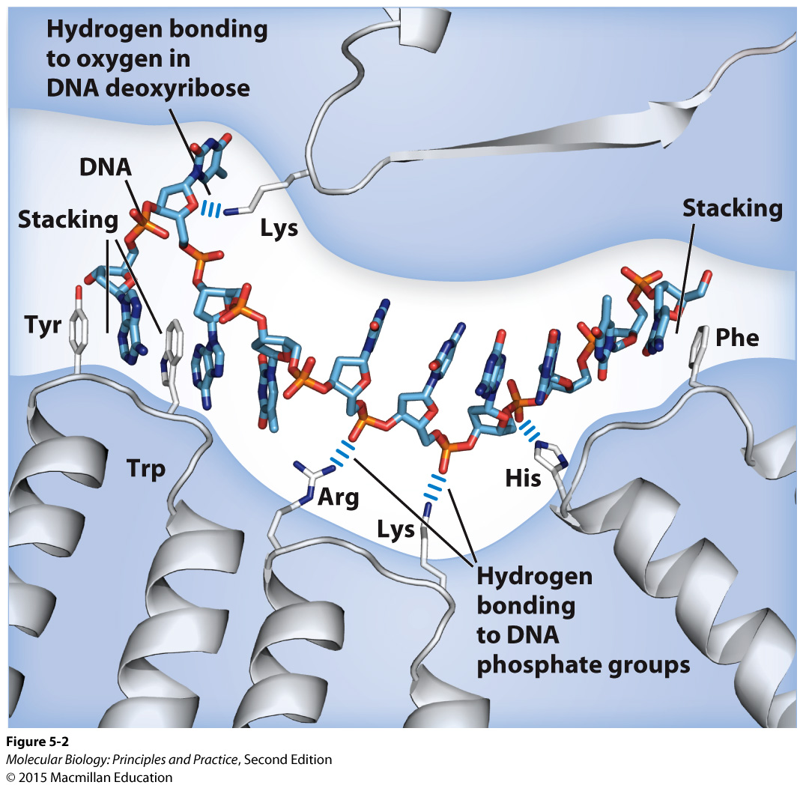
Examples of non-sequence-specific interactions between a single-stranded nucleic acid and a protein
Note that ss and ds nucleic acids will not bind to the same binding pocket (DNA binding proteins are usually structure-specific)

Slide 14
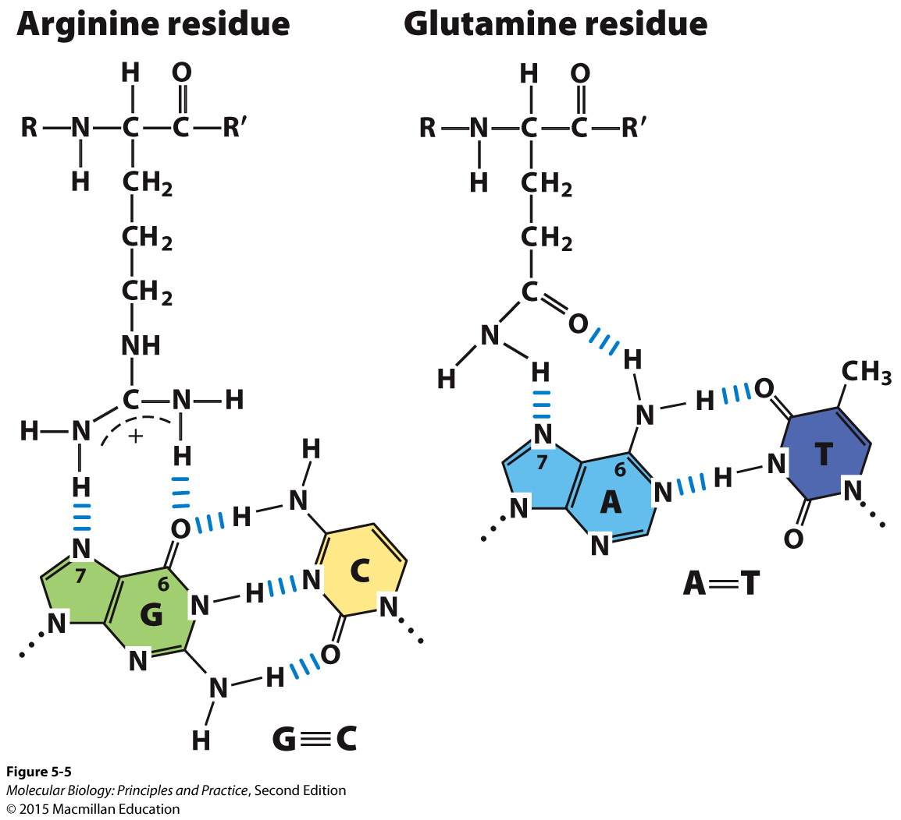
Examples of sequence-specific interactions between bases and amino acids
The bases are most often accessed at the major groove

Slide 15
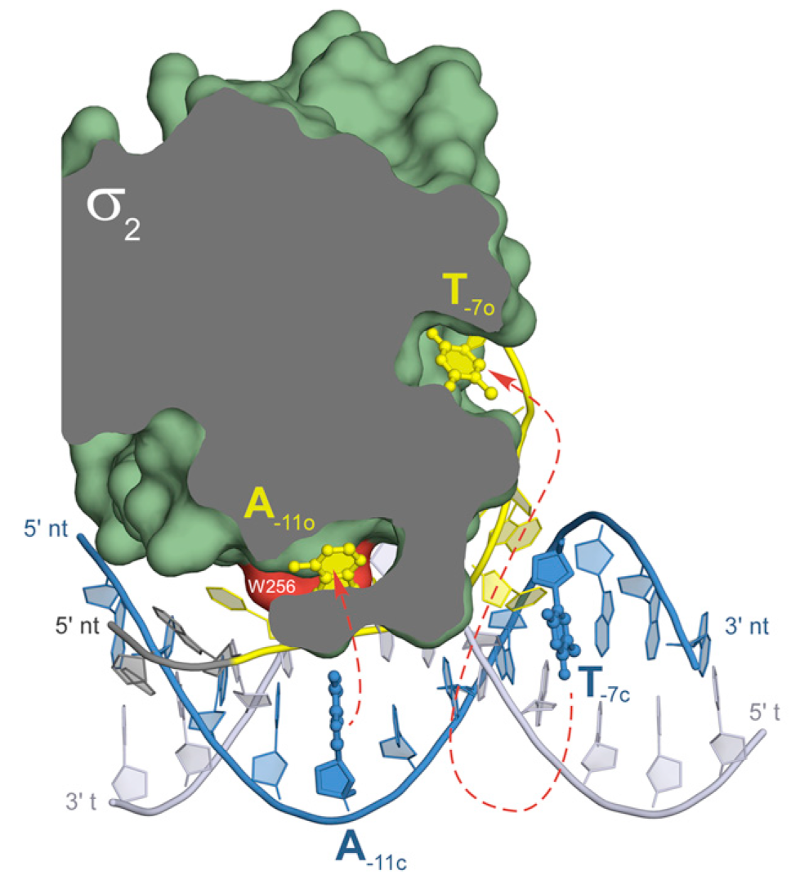
Bacterial sigma factor has two binding pockets for promoter A and T bases
Sequence-specific DNA binding may or may not involve disruption of the double helix
Feklistov, A., & Darst, S. A. (2011). Structural basis for promoter-10 element recognition by the bacterial RNA polymerase σ subunit. Cell, 147(6), 1257–1269. http://doi.org/10.1016/j.cell.2011.10.041

Slide 16
Genomes

Slide 17
Genome composition and strand usage
Viruses:
dsDNA
ssDNA
ssRNA (positive strand)
ssRNA (negative strand)
dsRNA
Cells:
dsDNA (genes encoded on both strands, though usually not simultaneously)

Slide 18
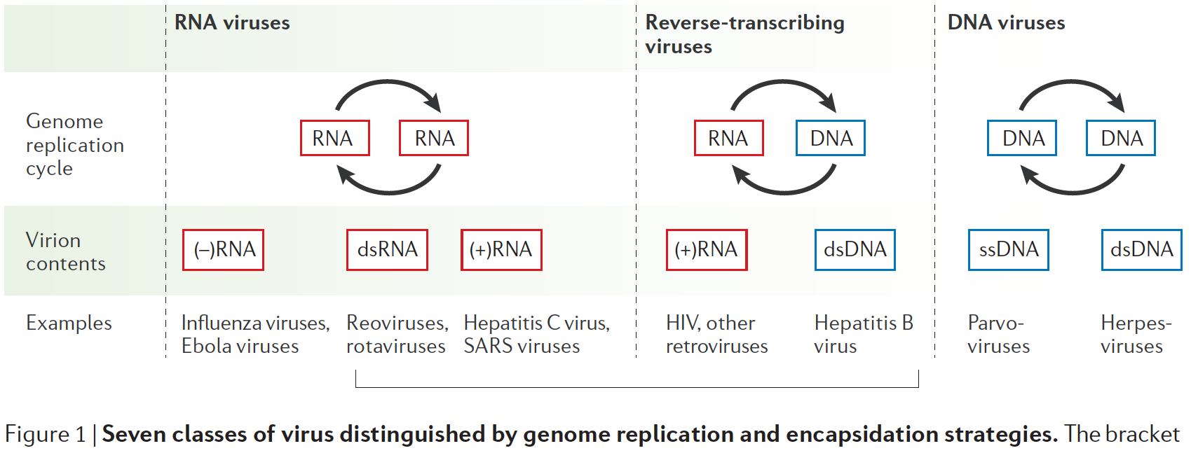
Viral genomes and replication strategies
Ahlquist, P. (2006) Nature Reviews Microbiology, 4(5), 371–382. http://doi.org/10.1038/nrmicro1389

